Slide 1
Ch 8 and 9
Async socket and Threads

Slide 2
Agenda
Ch # 8 and 9 : Asynchronous Socket (complete) & Threads
Assignment and project discussion
Mut-Ex (CR,RC, and deadlock)
Scheduling Algo ( Roundrobin, FCFS, shortest Job).
Task Manager
Process Lifecycle
Using System.Diagnostics;
Using System.Threading;
Ch 9 slides and book summary

Slide 3
Questions
How to find process info using c#
Difference in parameterized thread and thread start
Difference in Getcurrent Method and get processes(9.1-9.4)
Thread and multi threading (9.5-9.7)

Slide 4
Asynchronous socket
An asynchronous client socket does not suspend the application while waiting for network operations to complete. Instead, it uses the standard .NET Framework asynchronous programming model to process the network connection on one thread while the application continues to run on the original thread. Asynchronous sockets are appropriate for applications that make heavy use of the network or that cannot wait for network operations to complete before continuing
Notes:
make heavy use of the network or that cannot wait for network operations to complete before continuing

Slide 5
Threads
Processes are made up of one or more threads. A thread is defined as a single flow of operation within a program. When a program executes on the CPU, it traverses the program statements in a single thread until the thread is complete. A multithreaded application distributes functions among multiple program flows, allowing two or more paths of execution to occur. Each path of execution is a separate thread

Slide 6
How to avoid Blocking
Using .NET asynchronous sockets
Using traditional non-blocking socket methods (Using Threads)

Slide 7
Need of Asynchronous Socket
When server uses sync socket, it is waiting data from client , its main thread is blocked.
In asynchronous ,u can do other stuff while waiting for the client to send data to you, u can have multiple clients

Slide 8
AsyncCallback class
The .NET AsyncCallback class allows methods to start an asynchronous function and supply a delegate method to call when the asynchronous function completes. This process is different from standard event programming in that the event is not generated from a Windows object, but rather from another method in the program. This method itself registers an AsyncCallback delegate to call when the method completes its function. As soon as this occurs and the method indicates its completion to the Windows OS, an event is triggered to transfer the program control to the method defined in the registered AsyncCallback delegate.

Slide 9
Async callback VS Callback
A callback is a function that will be called when a process is done executing a specific task.
The usage of a callback is usually in asynchronous logic.
To create a callback in C#, you need to store a function address inside a variable.

Slide 10
Asynchronous methods
The Socket asynchronous methods split common network programming functions into two pieces:
• A Begin method that starts the network function and registers the AsyncCallback method
• An End method that completes the function when the AsyncCallback method is called

Slide 11
Establishing the Connection
Socket sock = new Socket(AddressFamily.InterNetwork, SocketType.Stream, ProtocolType.Tcp); IPEndPoint iep = new IPEndPoint(IPAddress.Any, 9050); sock.Bind(iep); sock.Listen(5); sock.BeginAccept(new AsyncCallback(CallAccept), sock);
Socket EndAccept(IAsyncResult iar);

Slide 12
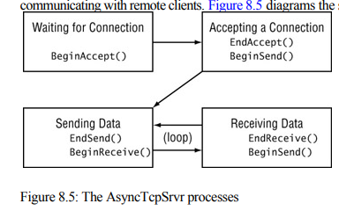
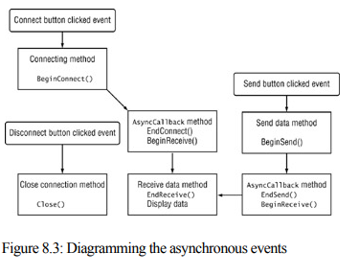
Client and server program flow
The AsyncTcpSrvr processes

Slide 13
Server code
public class ServerSocket
{
private Socket socket;
private byte[] buffer = new byte[1024];
public ServerSocket()
{
socket = new Socket(AddressFamily.InterNetwork, SocketType.Stream, ProtocolType.Tcp);
}
public void Bind(int port)
{
socket.Bind(new IPEndPoint(IPAddress.Any, port));
}
public void Listen(int backlog)
{
socket.Listen(500);
}

Slide 14
Server code
public void Accept()
{
socket.BeginAccept(AcceptedCallback, null);
}
private void AcceptedCallback(IAsyncResult result)
{
Socket clientsocket = socket.EndAccept(result);
buffer = new byte[1024];
clientsocket.BeginReceive(buffer, 0, buffer.Length, SocketFlags.None, ReceivedCallback, clientsocket);
Accept();}

Slide 15
Server code
private void ReceivedCallback(IAsyncResult result)
{
Socket clientsocket = result.AsyncState as Socket;
int bufferSize = clientsocket.EndReceive(result);
byte[] packet = new byte[bufferSize];
Array.Copy(buffer, packet, packet.Length);
buffer = new byte[1024];
clientsocket.BeginReceive(buffer, 0, buffer.Length, SocketFlags.None, ReceivedCallback, clientsocket);
}

Slide 16
Program.cs
public static ServerSocket serversocket = new ServerSocket();
static void Main(string[] args)
{
serversocket.Bind(6556);
serversocket.Listen(500);
serversocket.Accept();
while (true)
Console.ReadLine();
}

Slide 17
Client Code
public class Clientsocket{
private Socket ss;
private byte[] buffer;
public Clientsocket()
{ ss = new Socket(AddressFamily.InterNetwork, SocketType.Stream, ProtocolType.Tcp);}
public void connect(string ipaddress, int port)
{ ss.BeginConnect(new IPEndPoint(IPAddress.Parse(ipaddress), port), connectcallback, null);}
private void connectcallback(IAsyncResult result)
{Console.WriteLine(("connected to the server " ));
buffer = new byte[1024];
ss.BeginReceive(buffer, 0, buffer.Length, SocketFlags.None, ReceivedCallBack, null);}

Slide 18
private void ReceivedCallBack(IAsyncResult result)
{
int buflength = ss.EndReceive(result);
byte[] packet = new byte[buflength];
Array.Copy(buffer, packet, packet.Length);
buffer = new byte[1024];
ss.BeginReceive(buffer, 0, buffer.Length, SocketFlags.None, ReceivedCallBack, null);
}

Slide 19
Program.cs
class Program
{
private static Clientsocket client = new Clientsocket();
static void Main(string[] args)
{
client.connect("127.0.0.1", 6556);
while (true)
Console.ReadLine();
}
}
}

Slide 20
The Poll() Method
when you re attempting to perform a blocking network function such as a Receive() command, you need to have the capability of checking the socket before committing to the command.
The Socket method Poll() gives you just that. It checks a Socket object to see whether a network method call would block or be successfully completed.
If the poll indicates that the method would execute without blocking, you re home free.
Otherwise, you can perform some other functions and check again at a later time.
The format of the Poll() method is simple:
bool Poll(int microseconds, SelectMode mode);

Slide 21
It returns a simple boolean value: true if the action would complete,
or false if the action would block.
The int parameter allows you to set the amount of time (in microseconds) the Poll() method will wait and watch the socket for the indicated events.
Use the SelectMode parameter to specify what type of action to watch for. The SelectMode class enumerates three possible events (select read, select write, select error) for the Poll() method to monitor:

Slide 22
Ch #9
Threads

Slide 23
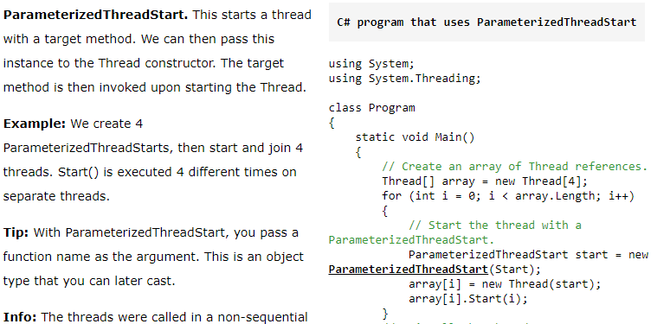
Parameterized thread and thread start

Slide 24
process priority
Allotment of CPU time for individual processes is determined by the process priority.
The Windows system uses two categories of process priorities:
• A priority class that defines a base priority for the process
• A specific priority level within the priority class to fine-tune the process priority

Slide 25
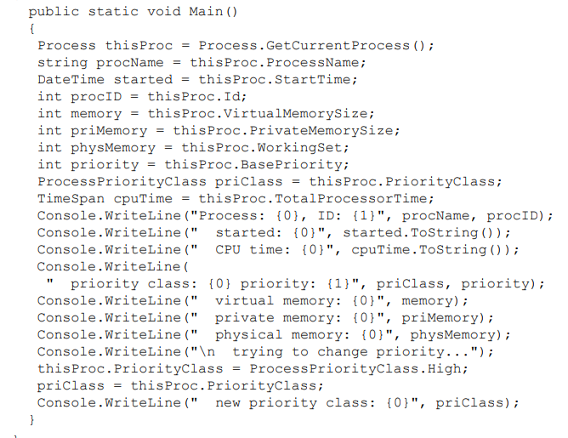

Slide 26
Info of All processes
Getcurrentmethod and getproccesses
For single current process and all

Slide 27
CPU Vs GPU
CPU stands for Central Processing Unit. | While GPU stands for Graphics Processing Unit.
CPU consumes or needs more memory than GPU. | While it consumes or requires less memory than CPU.
The speed of CPU is less than GPU’s speed. | While GPU is faster than CPU’s speed.
CPU contain minute powerful cores. | While it contain more weak cores.
CPU is suitable for serial instruction processing. | While GPU is not suitable for serial instruction processing.

Slide 28
